Slide 1

Getting Started

Slide 2
Why use PowerPoint?
PowerPoint is a presentation software.
  Gives listeners something to look at while you are talking.
Often used with a projector.
Illustrate your presentation.
  Text
  Pictures
  Sound
  Videos
Many of the Ribbons/Tabs at the top of the screen are very similar to those in MS Word.

Slide 3
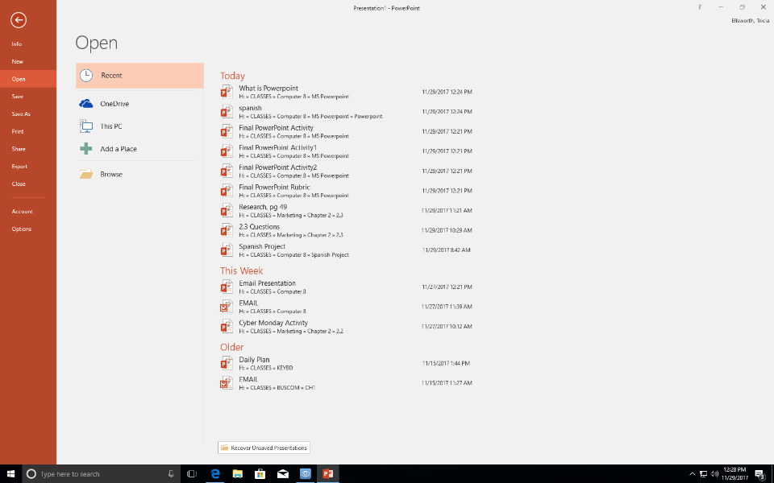
File Tab
Always SAVE FIRST!
  File - Save as
  Even before starting to create it, save it to O365.
  Then you won’t lose work if your computer dies.
The first time you open MS PowerPoint you may need to log in with your Office 365 credentials.
  Email address
  Password
Continue saving (control s) as you make changes to your presentation.

Slide 4
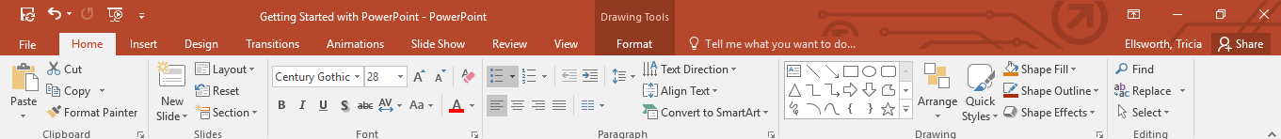
Home Tab
Slides Section is the only new part.
  Insert New Slide
  Slide Layout
The same as MS Word
  Clipboard
  Font
  Paragraph
  Editing

Slide 5
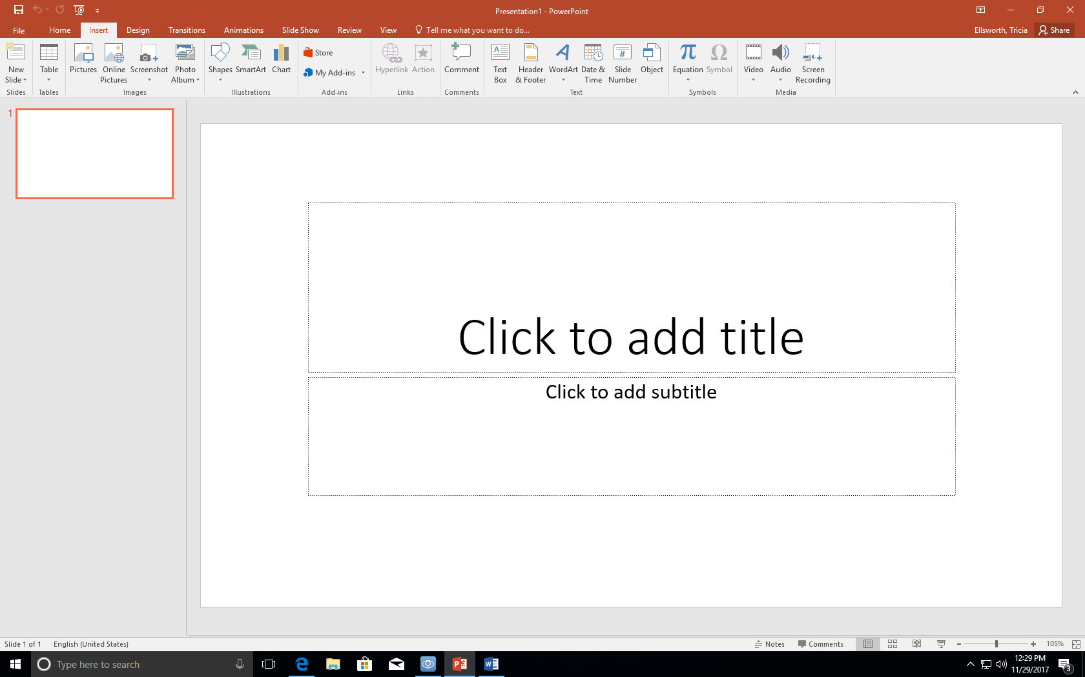
Insert Tab
Allows you to INSERT
  New Slide (control M)
  Pictures
  Charts
  Text Boxes
  Word Art
  Slide Numbers
  Etc.

Slide 6
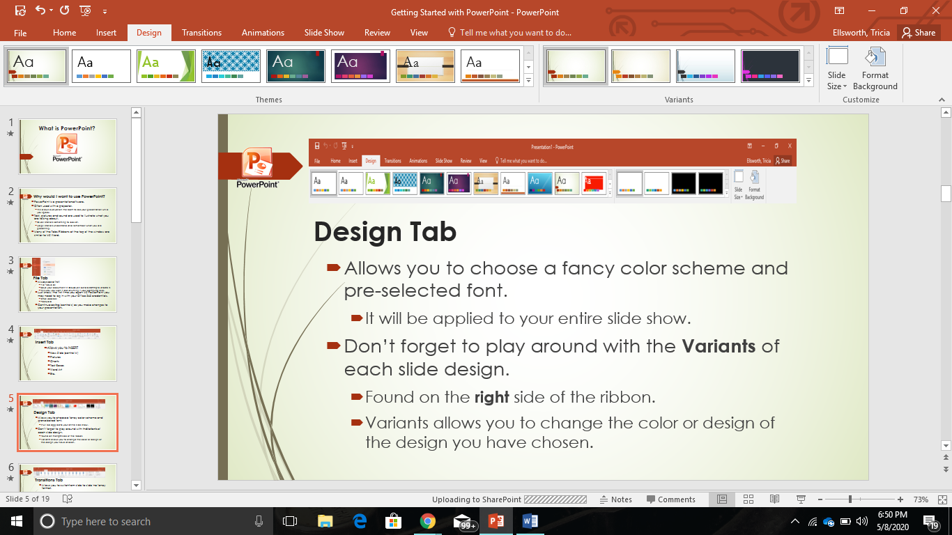
Design Tab
Allows you to choose a fancy Theme.
  It will be applied to your entire slide show.
Don’t forget to change the Variants of each slide design.
  Variants are found at the top right of the ribbon.
  Variants allow you to change the color or design of the Theme you have chosen.

Slide 7
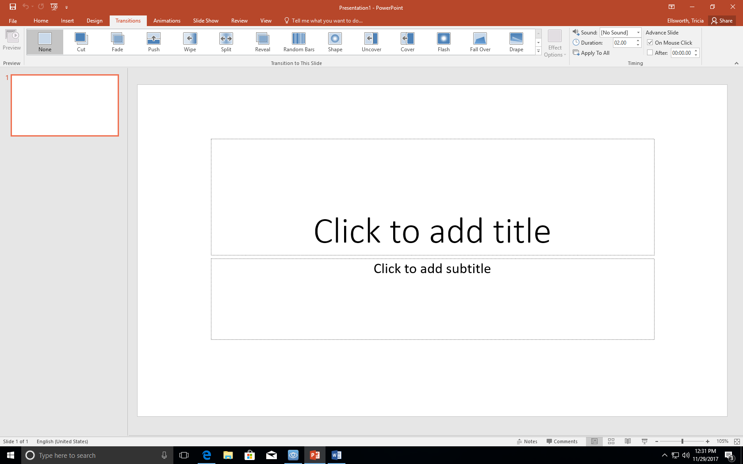
Transitions Tab
Allows you to switch from slide to slide in a fancy way.
With just one click you can apply a transition to the entire slide show.
  Pick a transition and then click “Apply to All.”
Did you notice how I applied different transitions between each slide in this presentation?
  I chose the Random Transition
  Then I selected “Apply to All”

Slide 8
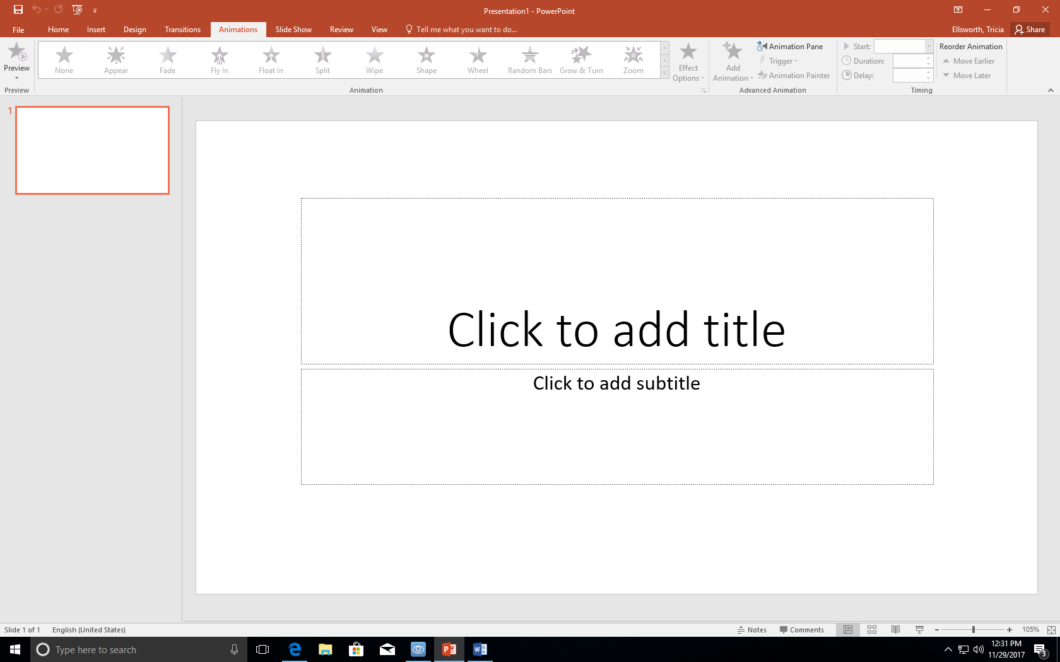
Animations Tab
Set your text to enter the slide show by
  the click of the mouse
  timed automatically
Animations MUST be added separately to each slide.
  There is no “Apply to All” choice like with Transitions.
If your animations enter in the wrong order…
  At the top right click Reorder Animation
    Either move earlier, or move later.
When presenting you can move through animations by
  Enter key, mouse click, the page up, page down, arrows.

Slide 9
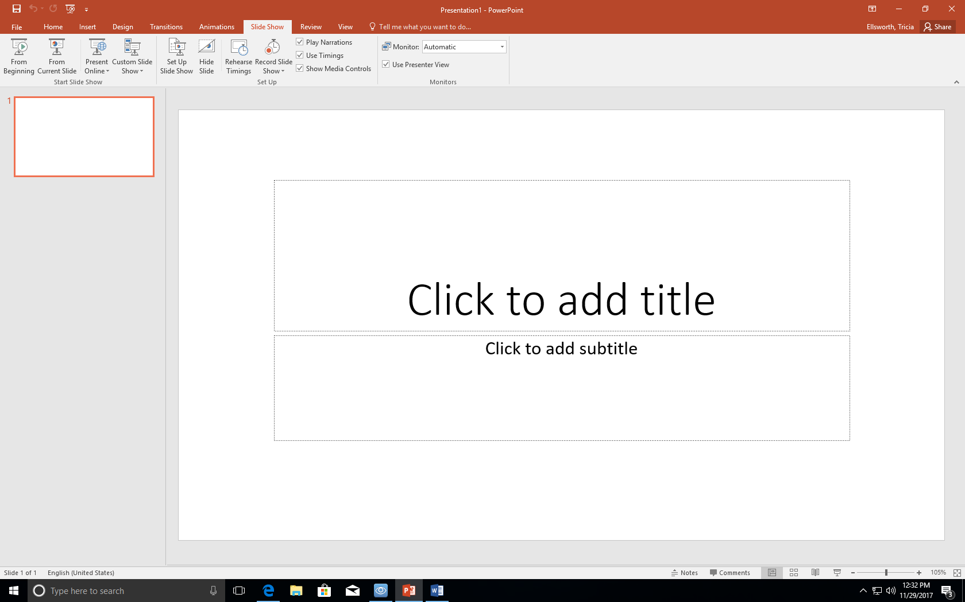
Slide Show Tab
Allows you to present your slide show and view your Transitions and Animations.
Choose where to start your slide show when presenting
  From the beginning
  From current slide
Short cut to start your presentation - F5 Key
  at the top of your keyboard.
Exit a presentation - Strike the Esc Key
  At the top left of your keyboard

Slide 10
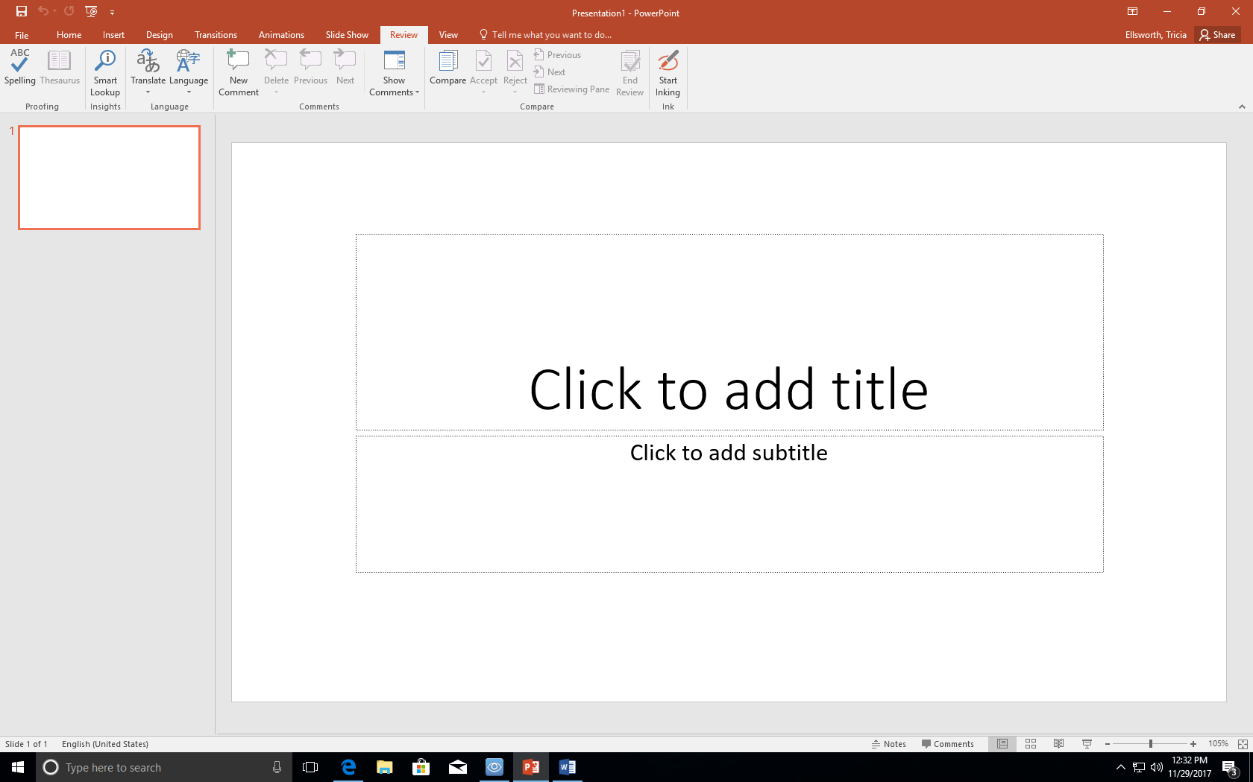
Review Tab
Very similar to MS Word.
This is where you can find
  Spell Check
  Thesaurus
  Language

Slide 11
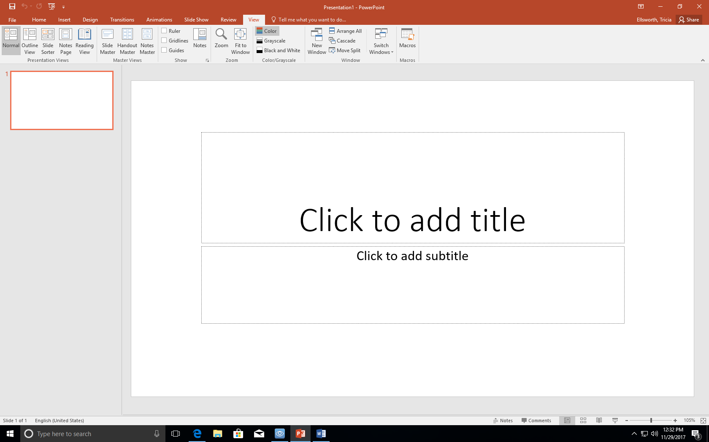
View Tab
Changes how you view the slide presentation on the screen while you are creating.
  Normal – small slides at the left, big slide in the center.
  Outline – outline to the left, big slide in the center.
  Slide Sorter – many small slides.
    Easy to move and reorganize your slide order.
  Slide Master – change slide layout for all.

Slide 12
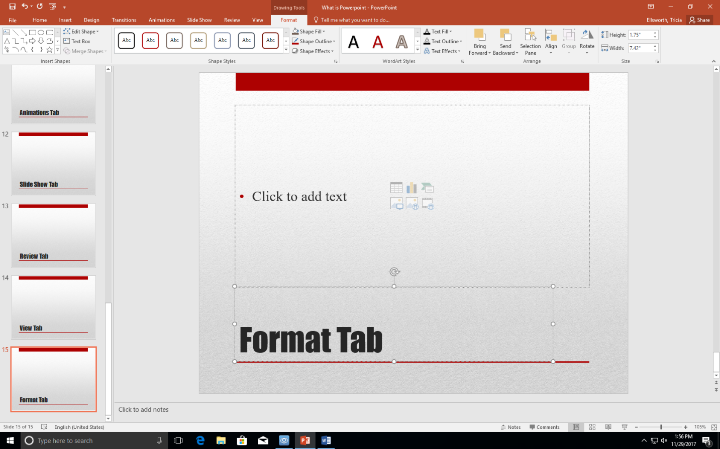
Format Tab
Also similar to MS Word.
This tab choices change with item selected.
  Shape
  Word Art
  Image
  Etc.

Slide 13
Remember Your Shortcuts
Ctrl s – save
Ctrl m –new slide
Ctrl a – selects all
Ctrl z - undo
Ctrl c - copy
Ctrl x – cut
Ctrl v – paste
Ctrl p – print

